Slide 1
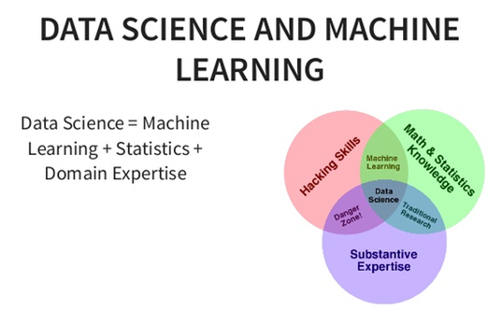
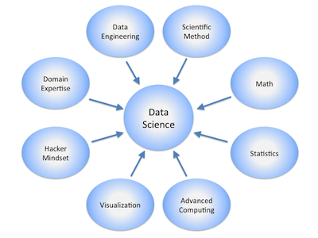


Data Science & Machine Learning
Hackathon (3rd & 4th November 2018)
> By
Clyde Mendonca
Krupa Shah
Sagar Kulkarni
Sagar Patil
Rajesh Brid

Slide 2
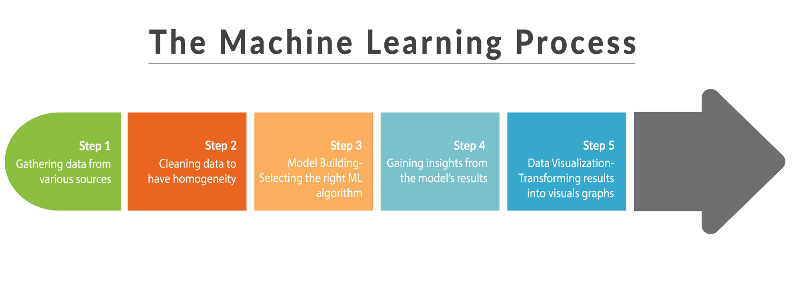
Synopsis
To build and deploy a Machine Learning (ML) Model that can predict your requirement of your problem statement, follow the steps below :
Setting the research goal
Retrieving Data
Data Preprocessing & Cleansing
Data Exploration & Visualization
Data Modeling
Model Deployment

Slide 3
Hackathon : Problem Statement
Problem Statement>> Bank Marketing : The data is related to direct marketing campaigns of a Portuguese banking institution. Predict if the client will subscribe to a term deposit based on a marketing campaign.
Data Set Information: The data is related to direct marketing campaigns of a Portuguese banking institution. The marketing campaigns were based on phone calls. Often, more than one contact to the same client was required, in order to access if the product (bank term deposit) would be ('yes') or not ('no') subscribed.
Goal:- The classification goal is to predict if the client will subscribe (yes/no) a term deposit (variable y).

Slide 4
Dataset Features
Input variables:
# bank client data:
1 - age (numeric)
2 - job : type of job (categorical: "admin.", "blue-collar", "entrepreneur", "housemaid", "management", "retired", "selfemployed", "services", "student", "technician", "unemployed", "unknown")
3 - marital : marital status (categorical: "divorced", "married", "single", "unknown"; note: "divorced" means divorced or widowed)
4 - education (categorical: "basic.4y", "basic.6y", "basic.9y", "high.school", "illiterate", "professional.course", "university.degree", "unknown")
5 - default: has credit in default? (categorical: "no", "yes", "unknown")
6 - housing: has housing loan? (categorical: "no", "yes", "unknown")
7 - loan: has personal loan? (categorical: "no", "yes", "unknown")
# related with the last contact of the current campaign:
8 - contact: contact communication type (categorical: "cellular", "telephone")
9 - month: last contact month of year (categorical: "jan", "feb", "mar", ..., "nov", "dec")
10 - day_of_week: last contact day of the week (categorical: "mon", "tue", "wed","thu", "fri")
11 - duration: last contact duration, in seconds (numeric). Important note: this attribute highly affects the output target (e.g., if duration=0 then y="no"). Yet, the duration is not known before a call is performed. Also, after the end of the call y is obviously known. Thus, this input should only be included for benchmark purposes and should be discarded if the intention is to have a realistic predictive model.

Slide 5
Dataset Features
# other attributes:
12 - campaign: number of contacts performed during this campaign and for this client (numeric, includes last contact)
13 - pdays: number of days that passed by after the client was last contacted from a previous campaign (numeric; 999 means client was not previously contacted)
14 - previous: number of contacts performed before this campaign and for this client (numeric)
15 - poutcome: outcome of the previous marketing campaign (categorical: "failure", "nonexistent", "success")
# social and economic context attributes
16 - emp.var.rate: employment variation rate - quarterly indicator (numeric)
17 - cons.price.idx: consumer price index - monthly indicator (numeric)
18 - cons.conf.idx: consumer confidence index - monthly indicator (numeric)
19 - euribor3m: euribor 3 month rate - daily indicator (numeric)
20 - nr.employed: number of employees - quarterly indicator (numeric)
Output variable (desired target):
21 - y - has the client subscribed a term deposit? (binary: "yes","no")

Slide 6
Dataset Features
df.shape : (41188, 21)
df.info() :
<class 'pandas.core.frame.DataFrame'>
RangeIndex: 41188 entries, 0 to 41187
Data columns (total 21 columns):
age 41188 non-null int64 job 41188 non-null object
marital 41188 non-null object education 41188 non-null object
default 41188 non-null object housing 41188 non-null object
loan 41188 non-null object contact 41188 non-null object
month 41188 non-null object day_of_week 41188 non-null object
duration 41188 non-null int64 campaign 41188 non-null int64
pdays 41188 non-null int64 previous 41188 non-null int64
poutcome 41188 non-null object emp.var.rate 41188 non-null float64
cons.price.idx 41188 non-null float64 cons.conf.idx 41188 non-null float64
euribor3m 41188 non-null float64 nr.employed 41188 non-null float64
y 41188 non-null object
dtypes: float64(5), int64(5), object(11)

Slide 7
Dataset Features
df.describe()
 | age | duration | campaign | pdays | previous | emp.var.rate | cons.price.idx | cons.conf.idx | euribor3m | nr.employed
count | 41188.00000 | 41188.000000 | 41188.000000 | 41188.000000 | 41188.000000 | 41188.000000 | 41188.000000 | 41188.000000 | 41188.000000 | 41188.000000
mean | 40.02406 | 258.285010 | 2.567593 | 962.475454 | 0.172963 | 0.081886 | 93.575664 | -40.502600 | 3.621291 | 5167.035911
std | 10.42125 | 259.279249 | 2.770014 | 186.910907 | 0.494901 | 1.570960 | 0.578840 | 4.628198 | 1.734447 | 72.251528
min | 17.00000 | 0.000000 | 1.000000 | 0.000000 | 0.000000 | -3.400000 | 92.201000 | -50.800000 | 0.634000 | 4963.600000
25% | 32.00000 | 102.000000 | 1.000000 | 999.000000 | 0.000000 | -1.800000 | 93.075000 | -42.700000 | 1.344000 | 5099.100000
50% | 38.00000 | 180.000000 | 2.000000 | 999.000000 | 0.000000 | 1.100000 | 93.749000 | -41.800000 | 4.857000 | 5191.000000
75% | 47.00000 | 319.000000 | 3.000000 | 999.000000 | 0.000000 | 1.400000 | 93.994000 | -36.400000 | 4.961000 | 5228.100000
max | 98.00000 | 4918.000000 | 56.000000 | 999.000000 | 7.000000 | 1.400000 | 94.767000 | -26.900000 | 5.045000 | 5228.100000

Slide 8
Building a ML Model
Libraries used :
import pandas as pd
import numpy as np
import seaborn as sns
import matplotlib.pyplot as plt
from sklearn.preprocessing import LabelEncoder
from sklearn.model_selection import cross_val_score, train_test_split
from sklearn.linear_model import LogisticRegression
from sklearn.metrics import classification_report, accuracy_score, confusion_matrix
from sklearn.svm import SVC
from sklearn.ensemble import RandomForestClassifier
from sklearn.feature_selection import RFE
from xgboost import XGBClassifier
from imblearn.over_sampling import SMOTE
from scipy.stats.mstats import winsorize
from sklearn.preprocessing import MinMaxScaler
from sklearn.model_selection import GridSearchCV
from sklearn.metrics import roc_curve, auc, roc_auc_score
from sklearn.naive_bayes import GaussianNB

Slide 9
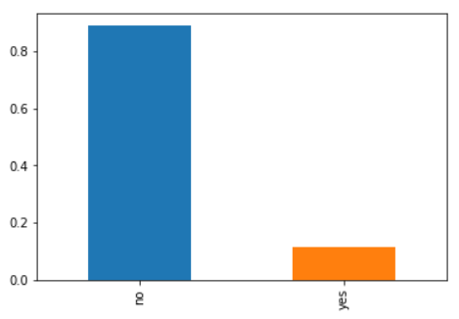
Data Cleaning & Exploration
Data Cleaning:
Cleaning Numerical features
Cleaning Categorical Features
Analysis of target variable
Class imbalance
Target variable : y

Slide 10
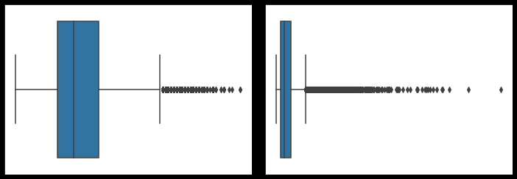
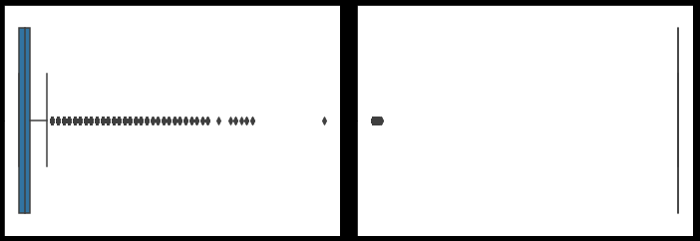
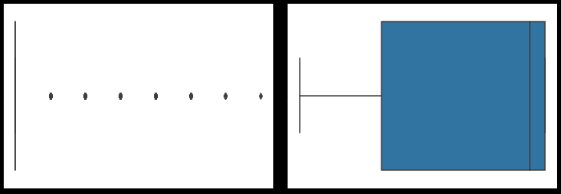
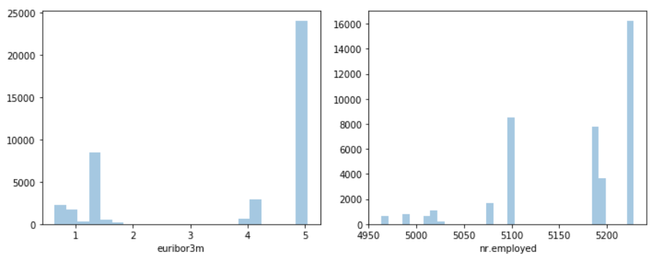
Data Exploration
Analysis of Numerical columns
Outliers in numerical columns:
age ----- 469 duration ----- 2963 campaign ----- 2406 pdays ----- 1515 nr.employed ----- 0
previous ----- 5625 emp.var.rate ----- 0 cons.price.idx ----- 0 cons.conf.idx ----- 447 euribor3m ----- 0
Age duration campaign pdays previous emp.var.rate
Distribution Graphs:

Slide 11
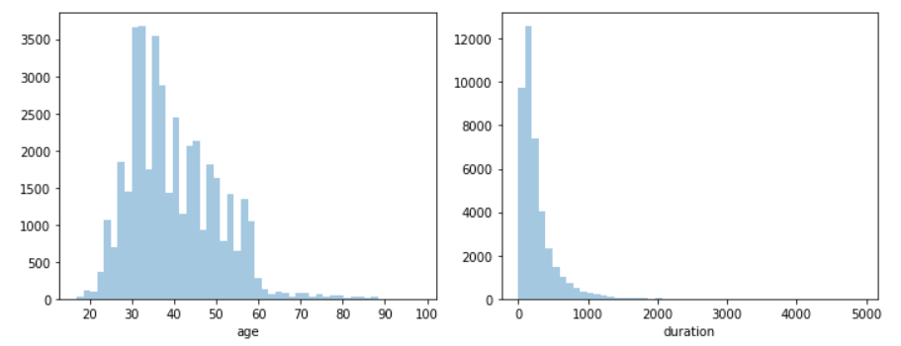
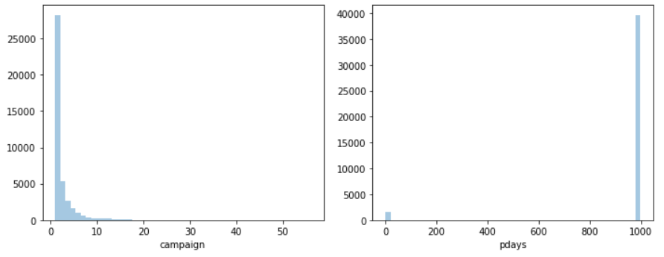
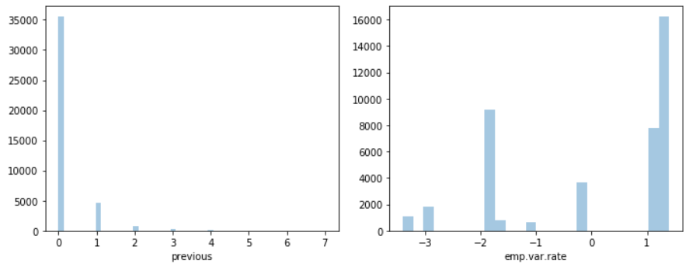
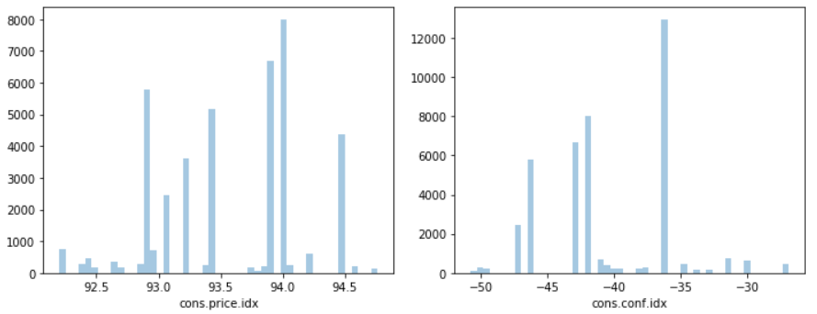
Data Exploration
Distribution Graphs

Slide 12
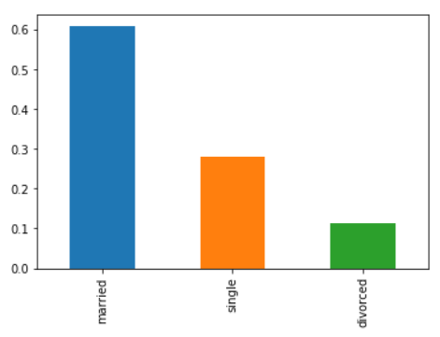
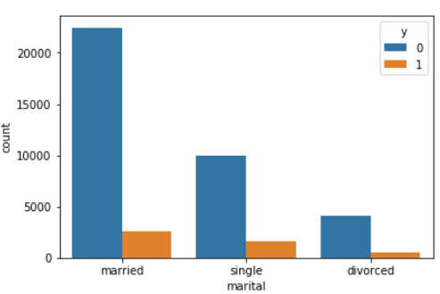
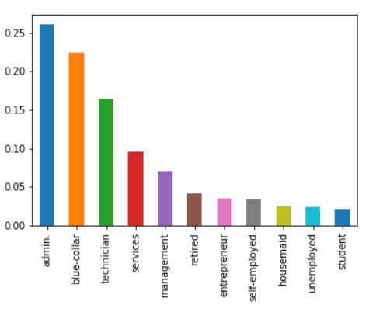
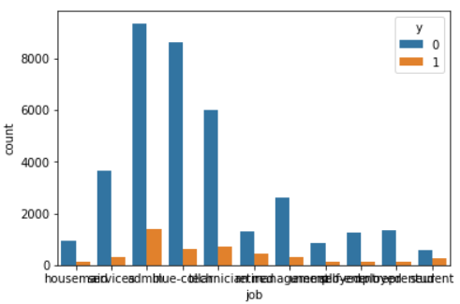
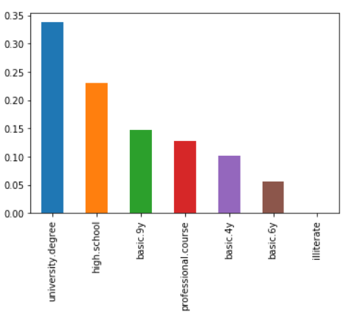
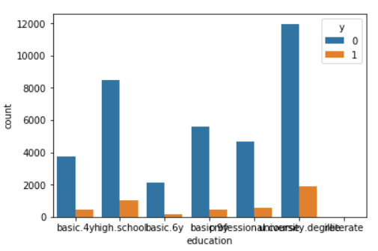
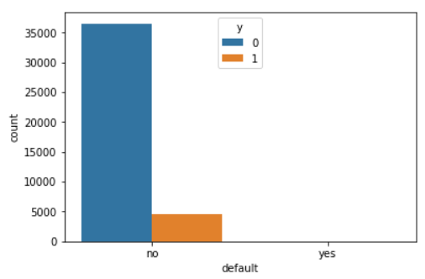
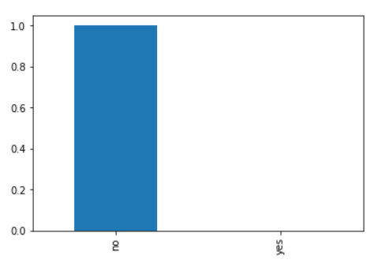
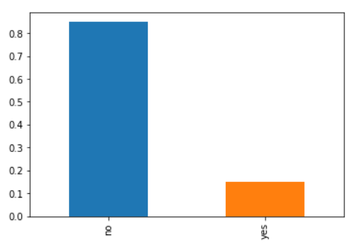
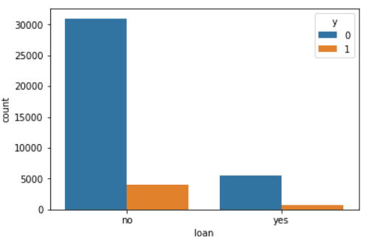
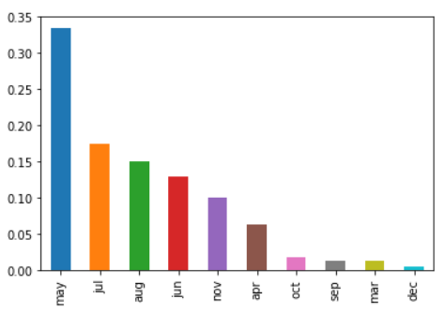
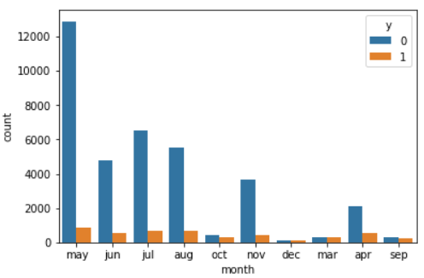
Data Exploration
Univariate analysis of Categorical columns & Graphs : Target (y) vs other features:
(up) marital job
(down) education default

Slide 13
Data Pre-processing
Dealing with Outliers :
Winsorization method
Column names | Outliers before Winsorization | Outliers after Winsorization
age | 469 | 0
duration | 2963 | 0
campaign | 2406 | 0
pdays | 1515 | 0
nr.employed | 0 | 0
previous | 5625 | 5625
Emp.var.rate | 0 | 0
Cons.price.idx | 0 | 0
Cons.conf.idx | 447 | 0
euribor3m | 0 | 0

Slide 14
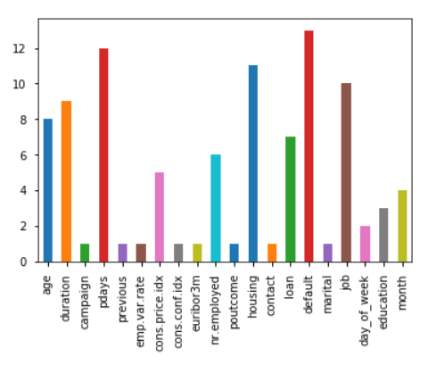
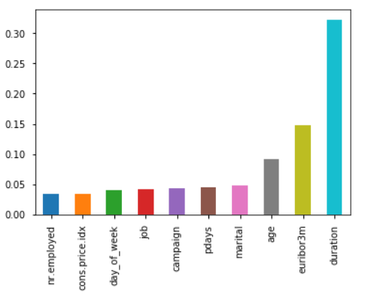
Feature Selection
Methods used :
RFE
Random Forest Classifier (RFC) feature importance
Correlation
RFE RFC

Slide 15
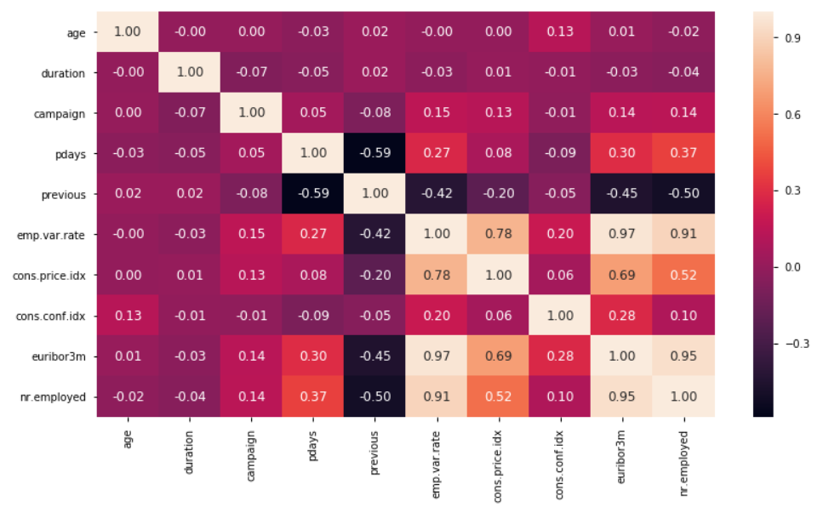
Feature Selection
Correlation matrix : corr = df.corr()
 | age | duration | campaign | pdays | previous | emp.var.rate | cons.price.idx | cons.conf.idx | euribor3m | nr.employed
age | 1.000000 | -0.000866 | 0.004594 | -0.034369 | 0.024365 | -0.000371 | 0.000857 | 0.129372 | 0.010767 | -0.017725
duration | -0.000866 | 1.000000 | -0.071699 | -0.047577 | 0.020640 | -0.027968 | 0.005312 | -0.008173 | -0.032897 | -0.044703
campaign | 0.004594 | -0.071699 | 1.000000 | 0.052584 | -0.079141 | 0.150754 | 0.127836 | -0.013733 | 0.135133 | 0.144095
pdays | -0.034369 | -0.047577 | 0.052584 | 1.000000 | -0.587514 | 0.271004 | 0.078889 | -0.091342 | 0.296899 | 0.372605
previous | 0.024365 | 0.020640 | -0.079141 | -0.587514 | 1.000000 | -0.420489 | -0.203130 | -0.050936 | -0.454494 | -0.501333
emp.var.rate | -0.000371 | -0.027968 | 0.150754 | 0.271004 | -0.420489 | 1.000000 | 0.775334 | 0.196041 | 0.972245 | 0.906970
cons.price.idx | 0.000857 | 0.005312 | 0.127836 | 0.078889 | -0.203130 | 0.775334 | 1.000000 | 0.058986 | 0.688230 | 0.522034
cons.conf.idx | 0.129372 | -0.008173 | -0.013733 | -0.091342 | -0.050936 | 0.196041 | 0.058986 | 1.000000 | 0.277686 | 0.100513
euribor3m | 0.010767 | -0.032897 | 0.135133 | 0.296899 | -0.454494 | 0.972245 | 0.688230 | 0.277686 | 1.000000 | 0.945154
nr.employed | -0.017725 | -0.044703 | 0.144095 | 0.372605 | -0.501333 | 0.906970 | 0.522034 | 0.100513 | 0.945154 | 1.000000

Slide 16
Feature Selection
Important Features : age, job, education, marital, loan, default, campaign, contact, pdays, poutcome, euribor3m
Dealing with Class imbalance:
SMOTE (to generate balanced data)
XGBoost
Target variable values | Recall
0 | 0.97
1 | 0.51

Slide 17
Model Selection
Models assessed :
Modeling method | Precision | Recall | AUC | ROC
Logistic Regression | 0: 0.90 | 0: 0.81 | 0.8580 | 0.8580
 | 1: 0.83 | 1: 0.90
Random Forest | 0: 0.96 | 0: 0.88 | 0.9186 | 0.9186
 | 1: 0.89 | 1: 0.96
Gaussian Naïve Bayes | 0: 0.74 | 0: 0.74 | 0.7394 | 0.7394
 | 1: 0.74 | 1: 0.74
KNN | 0: 0.98 | 0: 0.83 | 0.9062 | 0.9062
 | 1: 0.85 | 1: 0.98
XGBoost | 0: 0.92 | 0: 0.98 | 0.6761 | 0.6761
 | 1: 0.72 | 1: 0.37
Ensemble (with KNN & Random Forest) | 0: 0.93 | 1: 0.95 | 0.9392 | 0.9392
 | 1: 0.95 | 1: 0.93

Slide 18
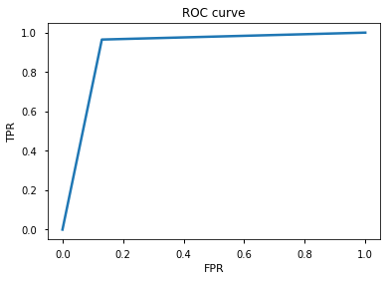
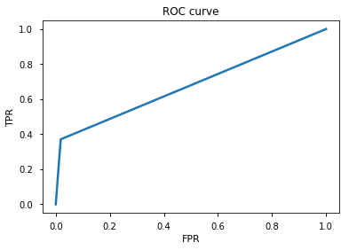
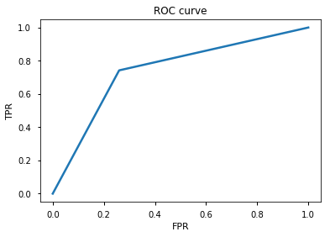

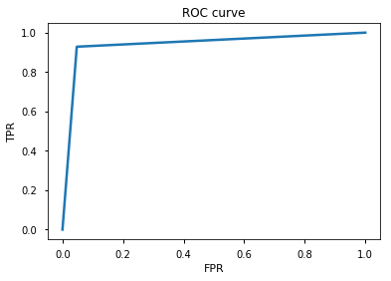
Model Selection
Up : Random Forest Gaussian Naïve Bayes XGBoost
Down : KNN Ensemble (KNN & Random Forest)

Slide 19
Model Selection
Selected Model :
Ensemble
Confusion Matrix :
 | Predicted Positive | Predicted Negative
Actual Positive | 10474 | 531
Actual Negative | 776 | 10148

Slide 20
Conclusion
Customers to be targeted:
Age : 30 – 50
Education : University, High School, Professional Courses
Job : Admin, Blue-collar, Technician
Campaign Targets:
Customers who were not targeted before
Plan campaigns from May through August

Slide 21

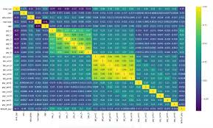


DS & ML - Hackathon

Slide 22


Hackathon Team : Clyde M., Krupa S., Sagar K., Sagar P. & Rajesh B.

